Slide 1

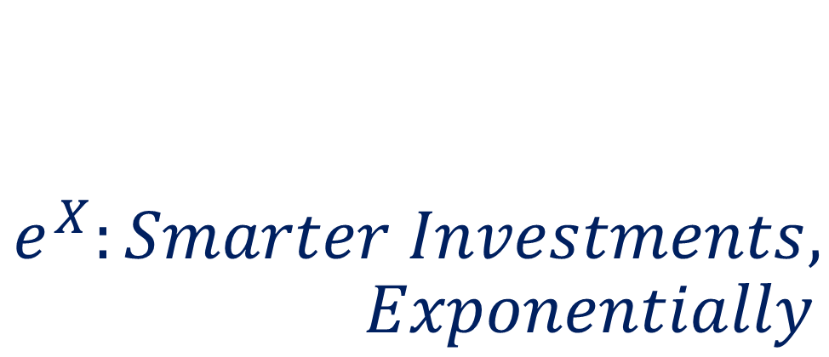
$$e^{X}:Smarter Investments, \\ Exponentially$$
Thomas Ferry, Nitin Sampath, Julian Chan, Mudit Goyal, Yuan Zho
Notes:
To change the image on this slide, select the picture and delete it. Then click the Pictures icon in the placeholder to insert your own image.

Slide 2
Outline
PROBLEM
PATH
SOLUTION
LIMITATIONS
NEXT STEPS

Slide 3

Problem
PROBLEM | PATH | SOLUTION | CONCLUSION
Notes:
In venture capital and private equity, predicting the success of a start-up is as much a science as it is an art. Sure business plans, customer metrics and financial models can help. The size of the addressable market as well as the product market-fit are also key success indicators. But early stage companies don’t have those; all they have is an idea and founders planning to execute upon it.
So how can we tell whether a company will be successful or not at such an early stage? By nature, it is a guess. However, when millions of dollars are at stake, it is crucial for our guess to be as educated as possible. This is what we are trying to achieve with e^x: smarter investments, exponentially. We use data science to provide investors with additional insight to help them predict the success of a founder.
However, as we started ideating about our solution we were faced with a problem: How do we define success?

Slide 4
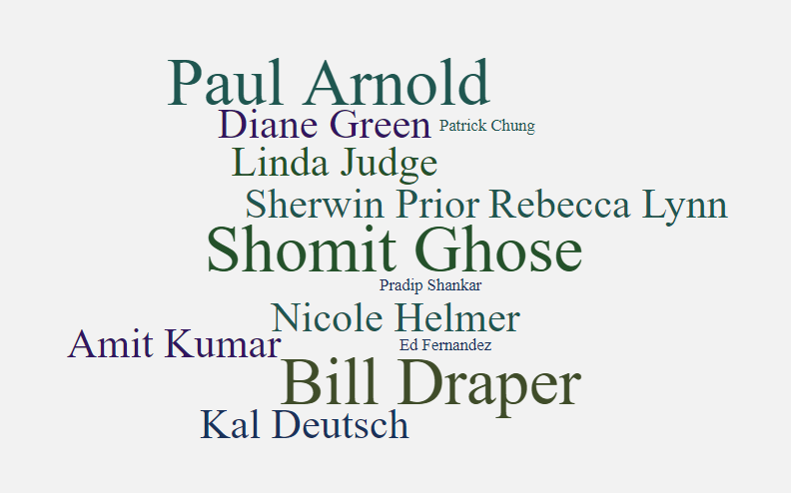
Interviews
PROBLEM | PATH | SOLUTION | CONCLUSION
Notes:
We talked to numerous VCs to define a measure of success. Our measure of success was if The start-up increases valuation from seed to Series a and from Series A to Series B while maintaining its CEO. In addition, we got the insight to focus on early stage startups.

Slide 5
Plan 1
ML
Founder 1
….
Founder N
Predicted Increase in Valuation
PROBLEM | PATH | SOLUTION | CONCLUSION
Notes:
Initially we wanted to create a system to predict the increase in valuation for a founder’s company. After this, we would build a regression machine learning model and use this to predict the valuation of the founders.

Slide 6
Plan 1
1500 founders * 54 features
81,000 data points
Enough for a prototype regression model
PROBLEM | PATH | SOLUTION | CONCLUSION
Notes:
To start this, we developed a dataset of 1500 founders and 54 different features over 80,000 data points which is enough for a prototype regression model which we thought would be enough.

Slide 7
Roadblock
1500 founders * 54 features
No automation | Limited Time
700 founders * 14 features
PROBLEM | PATH | SOLUTION | CONCLUSION
Notes:
We were able to pull valuation information from 1500 founders on Crunchbase and brainstormed 54 features that we thought were relevant to success. We broadly identified traits such as coachability and communication and came up with more specific features that fell under those categories. So at the end of our brainstorming phase, we were looking to collect 54 pieces of data on each of our 1500 founders.
However, spending time talking to VC firms and representatives for guidance on what they looked for in a founder for success as well as needing to set aside time for data cleaning, algorithm development and testing, and front-end integration meant that we didn’t nearly have enough time to collect so much data. In addition, many of the features we thought of such as sentiment analysis on articles about the founder and average income of hometown took a significant amount of time to collect due to limited availability and we felt the risk vs. reward just wasn’t worth it for our purpose. So we decided to scrap a lot of those features and were left with 14 features that were reasonably easy to collect and we were only able to do so on 700 founders due to time constraints.
Make sure you talk about how we switched solutions and describe our new solutions.

Slide 8
Plan 2
Regressor
Founder 1
….
Founder N
Similarity Calculator
Weights
PROBLEM | PATH | SOLUTION | CONCLUSION

Slide 9
Processing & Feature Engineering
700 founders * 14 features
Standardize| Group | Clean
337 founders * 16 features
PROBLEM | PATH | SOLUTION | CONCLUSION

Slide 10
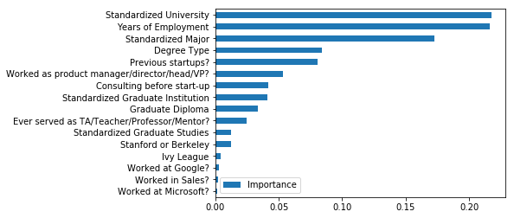
Weights
RFR
Importance
Weights
PROBLEM | PATH | SOLUTION | CONCLUSION

Slide 11
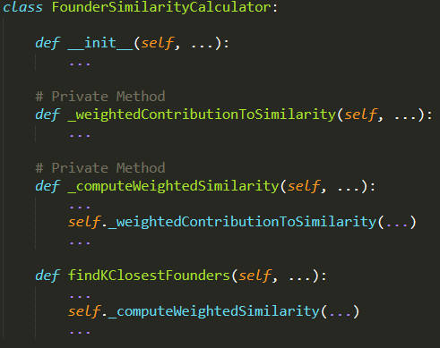
Similarity Score
Weights
Weighted Sum
Similarity Score
PROBLEM | PATH | SOLUTION | CONCLUSION

Slide 12
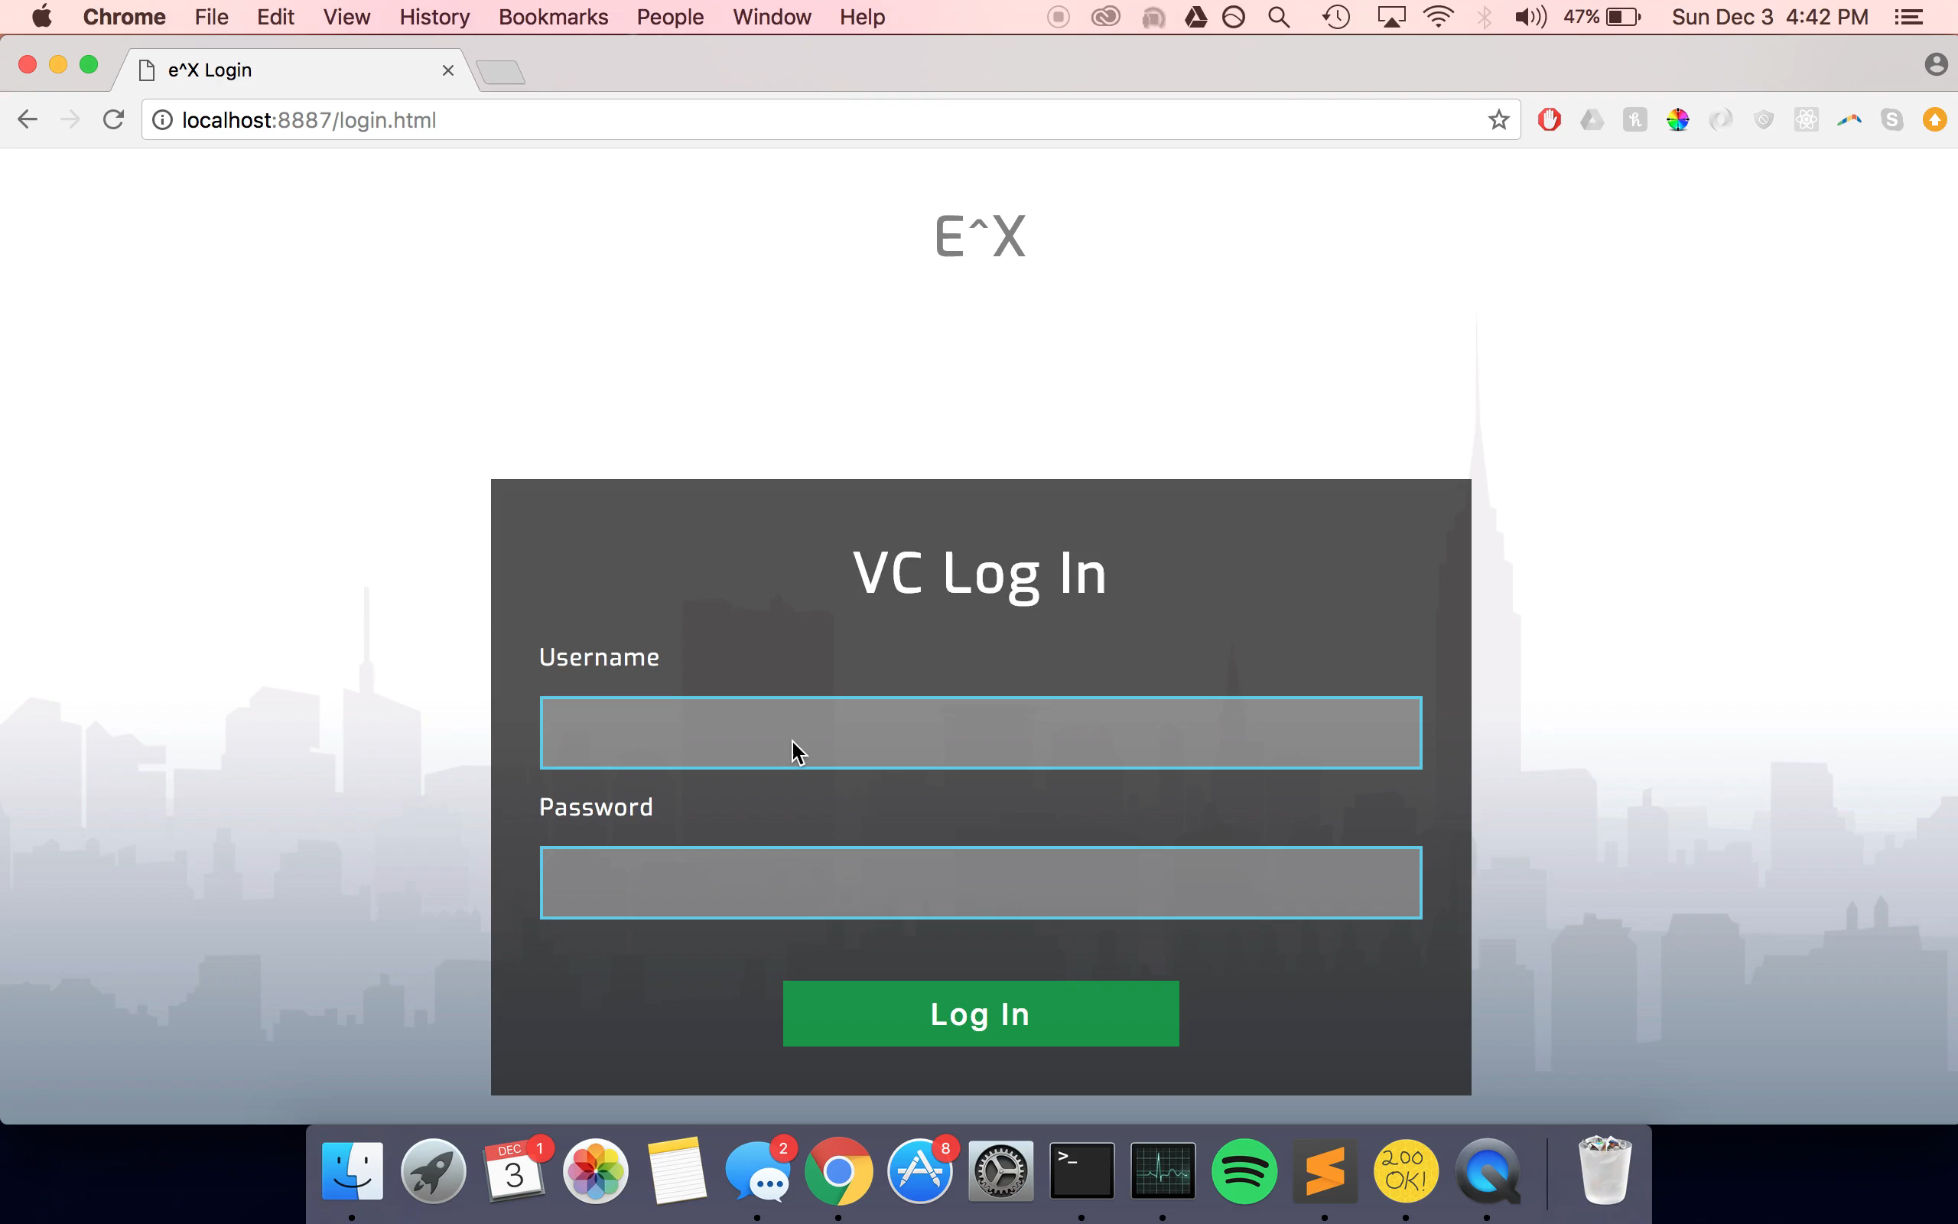
Demo & UI
PROBLEM | PATH | SOLUTION | CONCLUSION

Slide 13



Limitations
Limited Data Amount
Biases
Limited Data Sources
PROBLEM | PATH | SOLUTION | CONCLUSION

Slide 14
Next Steps
Increase amount of features
Scale data collection
Build robust architecture
PROBLEM | PATH | SOLUTION | CONCLUSION

Slide 15
Thank you! QUESTIONS ?

Slide 16
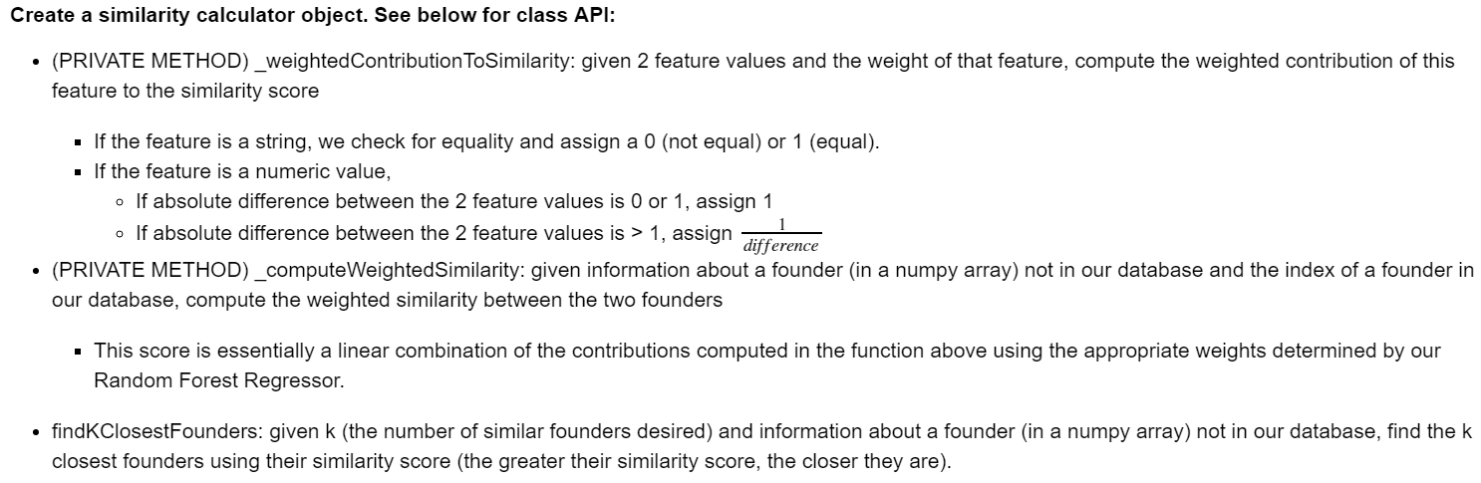
API
PROBLEM | PATH | SOLUTION | CONCLUSION

Slide 17
